Slide 1


Anno Accademico 2022 – 2023
Software Architecture
Alexandru Nicolae Andrei 829570 Giacomo Savazzi 845372 Andrea Assirelli 820149
November 29, 2022

Slide 2
Anno Accademico 2022 – 2023
In Depth Study - Security
If you reveal your secrets to the winds, you should not blame the wind for revealing them to the trees.
- Kahlil Gibran

Slide 3
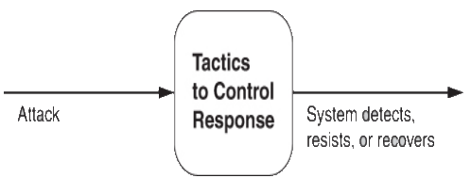
Anno Accademico 2022 – 2023
Tactics for Security

Slide 4

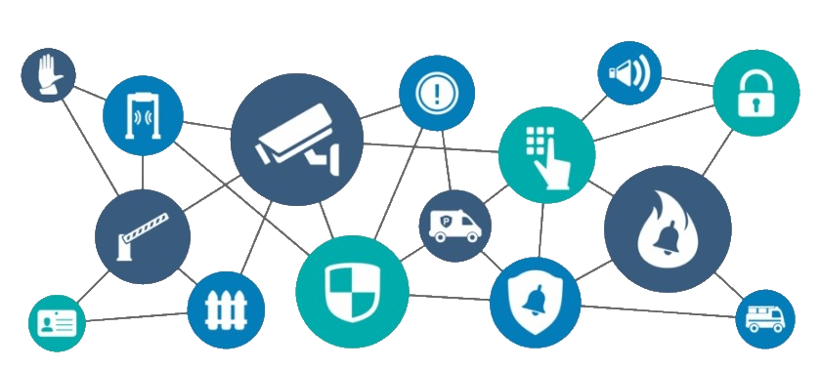
First Step – Physical Security
Limited access (e.g., fences and security checkpoint);
Detecting intruders (e.g., visitors with badges);
Deterrence mechanisms (e.g., armed guards);
Reaction mechanisms (e.g., doors automatic lock, acoustic alarm);
Recovery mechanisms (e.g., off-site backup);

Slide 5
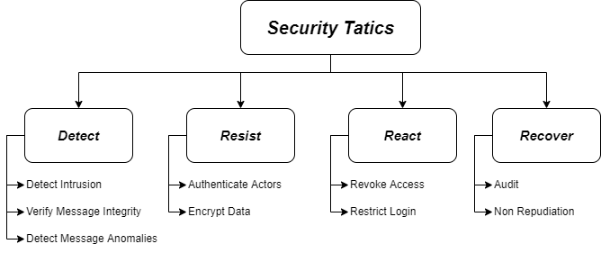
Categories of Tactics
Detect Attacks: identify attacks before it takes effect;
Resist Attacks: prevent possible attack;
React to Attacks: resist to ongoing attacks;
Recover from Attacks: restore system successful attacks;

Slide 6

Categories of Tactics – Detect Attacks
Detect Intrusion: compares network traffic with a set of known malicious patterns, based on payload size, port number, source or destination address etc.;
Verify message Integrity: using of techniques, like checksum or hash value, to verify the integrity of messages, resource file, configuration files etc.;
Detect message delivery anomalies: detect potential man-in-the-middle attack. Can be indicated by too long time for sending or receiving, or abnormal number of connection and disconnecting during communication;

Slide 7

Categories of Tactics – Resist Attacks
Authenticate Actors: ensuring that an actor is actually who (or what) it purports to be. Techniques to do that are password, OTP, biometric identification etc. Another example is CAPTCHA, a challenge-response test, used to verify if the user is human or not;
Encrypt Data: provide extra protection on confidential data. This is the only useful protection for passing data over public access network;

Slide 8

Categories of Tactics – React to Attacks
Revoke Access: if the system notice that an attack is under way, access can be limited for sensitive resources, even for legitimate users, until the attack was not interrupted;
Restrict Login: repeated failed login may indicate an attack, so we can limit access to a particular system after several failed login attempt. The lock-out period must be considered only for a certain period of time, because also legitimate users can make mistakes;

Slide 9

Categories of Tactics – Recover from Attacks
Audit: keep a record of user, system actions and their effects, to help trace all actions, and in case, identify an attacker. We can also analyze audit to see attack pattern, and create better defenses for future;
Non Repudiation: guarantees that the sender of a message cannot deny the send of that message, and same of the receiver. This could be achieved with combination of digital signature and authentication by trusted parties;

Slide 10
Thanks for Your Attention

